Slide 1
Wrapper Learning
Craig Knoblock
University of Southern California
This presentation is based on slides prepared by Ion Muslea and Kristina Lerman

Slide 2
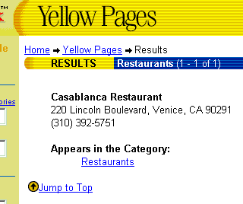
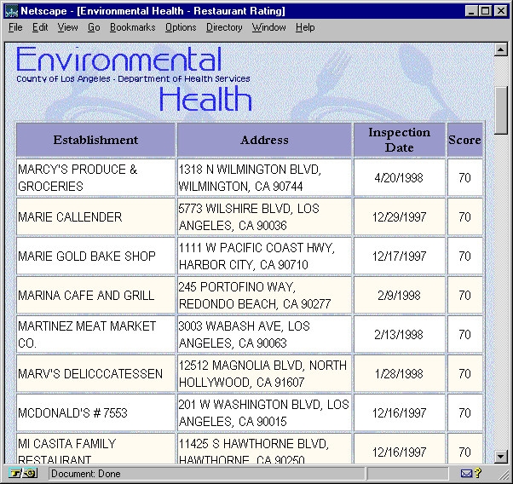
Wrappers & Information Integration
Thai
< $20
GIVE ME: Thai food
< $20
“A”-rated
A
G
E
N
T
“A”rated

Slide 3
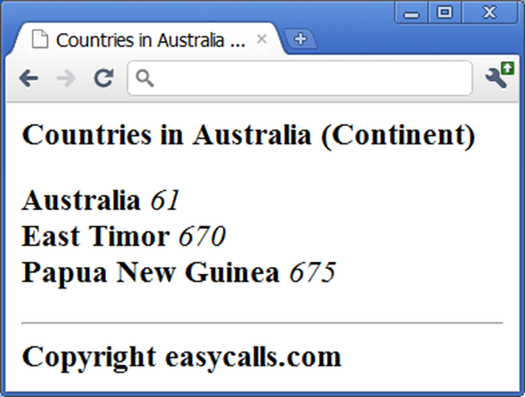
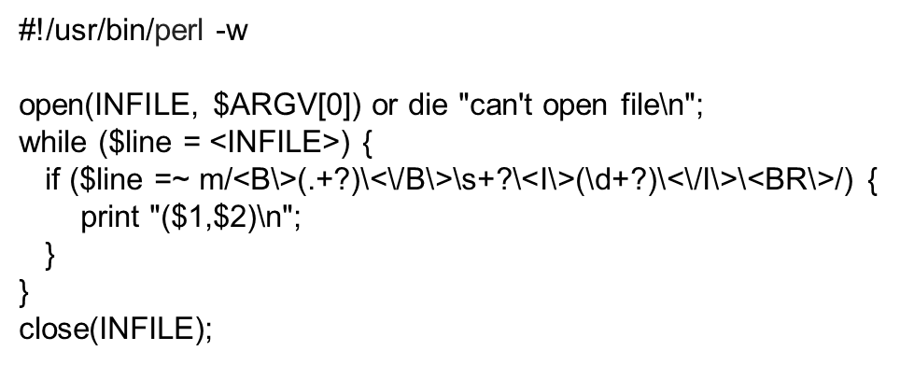
Manual Wraper Construction
Developer examines a set of Web pages
manually creates target schema T_{W} and extraction program E_{W}
often writes E_{W} using a procedural language such as Perl

Slide 4
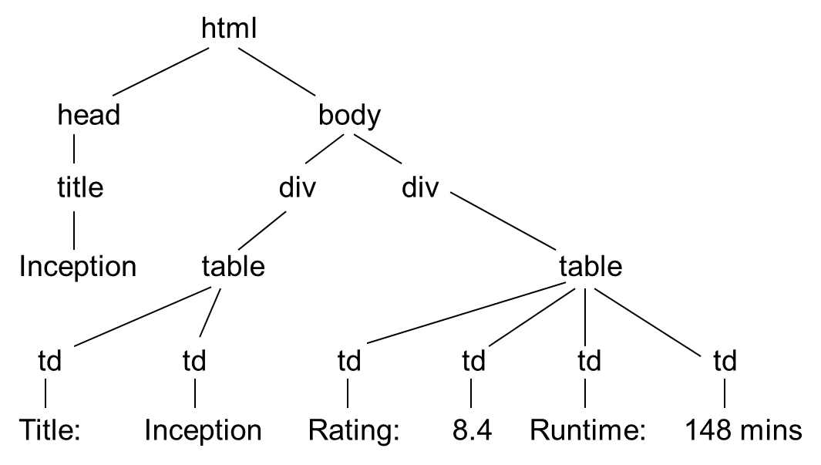
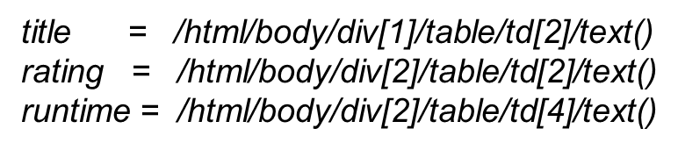
Manual Wrapper Construction
There are multiple ways to view a page
as a string ➔ can write wrapper as Perl program
as a DOM tree ➔ can write wrapper using XPath language
as a visual page, consisting of blocks

Slide 5
Manual Wrapper Construction
Regardless of page model (string, DOM tree, visual, etc.), using a low-level procedural language to write E_{W} can be very laborious
High-level wrapper languages have been proposed
E.g., HLRT language
see the next part on learning
Using high-level language often result in loss of expressiveness
But they are often easier to understand, debug, and maintain

Slide 6
Wrapper Induction
Problem description:
Web sources present data in human-readable format
take user query
apply it to data base
present results in “template” HTML page
To integrate data from multiple sources, one must first extract relevant information from Web pages
Task: learn extraction rules based on labeled examples
Hand-writing rules is tedious, error prone, and time consuming

Slide 7
Example of Extraction Task
NAME Casablanca Restaurant
STREET 220 Lincoln Boulevard
CITY Venice
PHONE (310) 392-5751
Notes:
As the quantity and diversity of the information available online increases, more of the common information access tasks are done by program such as web wrappers. Wrappers faciliate access to Web-based information sources by providing a uniform querying and data extraction capability. For example, a Web wrapper for the yellow pages source can take a query for a Mexican restaurant near Marina del Rey, CA, and extract the restaurant’s name, its address and the phone number, in the same way as the information is extracted from a database.

Slide 8
In this part of the lecture …
Wrapper Induction Systems
WIEN:
The rules
Learning WIEN rules
The STALKER approach to wrapper induction
The rules
The ECTs
Learning the rules
Wrapper validation and maintenance

Slide 9
WIEN [Kushmerick et al ‘97, ‘00]
Assumes items are always in fixed, known order
… Name: J. Doe; Address: 1 Main; Phone: 111-1111. <p>
Name: E. Poe; Address: 10 Pico; Phone: 777-1111. <p> …
Introduces several types of wrappers
LR:
Name:
; :
Addr
; :
Phone
.
Name
Notes:
Our objective is to learn the structure of common data fields, such as street addresses. One way to represent information is as a sequence of characters, such as a regular expression. This description is very powerful; however, many common data types don’t have a well defined grammar, or it may be computationally expensive to learn it.
Another way to represent information is as a collection of global features, such as the number of words and the density of numeric characters. These descriptions can be learned very quickly, but we believe that representation level is too coarse for some information management tasks.
We propose an intermediate token-level representation that balances the descriptive power and specificity of the character-level representation with the compactness and computational efficiency of the global representation.

Slide 10
Wrapper Types
LR
L and R delimit each of the k attributes
HLRT
Two additional strings:
H marks the end of the header
T marks the beginning of the tail
BELR
B & E mark the beginning and end of each tuple (row of data in the page)
HBELRT
??

Slide 11
Rule Learning
Machine learning:
Goal: Find a instance of the given wrapper type that covers the given examples
INPUT:
Labeled examples: training & testing data
Admissible rules (hypotheses space)
Search strategy
Desired output:
Rule that performs well both on training and testing data
Termination
Train on sufficient data to be provably approximately correct (PAC)

Slide 12
Learning LR extraction rules
<html> Name:<b> Kim’s </b> Phone:<b> (800) 757-1111 </b> …
<html> Name:<b> Joe’s </b> Phone:<b> (888) 111-1111 </b> …

Slide 13
Learning LR extraction rules
Admissible rules:
prefixes & suffixes of items of interest
Search strategy:
start with shortest prefix & suffix, and expand until correct
<html> Name:<b> Kim’s </b> Phone:<b> (800) 757-1111 </b> …
<html> Name:<b> Joe’s </b> Phone:<b> (888) 111-1111 </b> …

Slide 14
Learning LR extraction rules
Admissible rules:
prefixes & suffixes of items of interest
Search strategy:
start with shortest prefix & suffix, and expand until correct
<html> Name:<b> Kim’s </b> Phone:<b> (800) 757-1111 </b> …
<html> Name:<b> Joe’s </b> Phone:<b> (888) 111-1111 </b> …
>
< >
<
Name
Phone

Slide 15
Learning LR extraction rules
Admissible rules:
prefixes & suffixes of items of interest
Search strategy:
start with shortest prefix & suffix, and expand until correct
<html> Name:<b> Kim’s </b> Phone:<b> (800) 757-1111 </b> …
<html> Name:<b> Joe’s </b> Phone:<b> (888) 111-1111 </b> …
b>
< >
<
Name
Phone

Slide 16
Learning LR extraction rules
Admissible rules:
prefixes & suffixes of items of interest
Search strategy:
start with shortest prefix & suffix, and expand until correct
<html> Name:<b> Kim’s </b> Phone:<b> (800) 757-1111 </b> …
<html> Name:<b> Joe’s </b> Phone:<b> (888) 111-1111 </b> …
b>
< b>
<
Name
Phone

Slide 17
Learning LR extraction rules
Admissible rules:
prefixes & suffixes of items of interest
Search strategy:
start with shortest prefix & suffix, and expand until correct
<html> Name:<b> Kim’s </b> Phone:<b> (800) 757-1111 </b> …
<html> Name:<b> Joe’s </b> Phone:<b> (888) 111-1111 </b> …
b>
< <b>
<
Name
Phone

Slide 18
Labeling Data
Instead of labeling all of the data, use recognizers to find instances of a particular attribute
Recognizers may be:
Perfect
Accept all positive instances and reject all negatives
Incomplete
Reject all negative instances but reject some positives
Unsound
Accept all positive, but accept some negatives
Unreliable
Reject some positive instances and accept some negatives

Slide 19
Summary
Advantages:
Fast to learn & extract
Some sources could be labeled automatically given an appropriate set of recognizers
Drawbacks:
Cannot handle permutations and missing items
Entire page must be labeled
Requires large number of examples

Slide 20
In this part of the lecture …
Wrapper Induction Systems
WIEN:
The rules
Learning WIEN rules
The STALKER approach to wrapper induction
The rules
The ECTs
Learning the rules
Wrapper validation and maintenance

Slide 21
STALKER [Muslea et al, ’98 ’99 ’01]
Hierarchical wrapper induction
Decomposes a hard problem in several easier ones
Extracts items independently of each other
Each rule is a finite automaton
Notes:
Our objective is to learn the structure of common data fields, such as street addresses. One way to represent information is as a sequence of characters, such as a regular expression. This description is very powerful; however, many common data types don’t have a well defined grammar, or it may be computationally expensive to learn it.
Another way to represent information is as a collection of global features, such as the number of words and the density of numeric characters. These descriptions can be learned very quickly, but we believe that representation level is too coarse for some information management tasks.
We propose an intermediate token-level representation that balances the descriptive power and specificity of the character-level representation with the compactness and computational efficiency of the global representation.

Slide 22
STALKER: The Wrapper Architecture
Query
Data
Information Extractor
EC Tree
Extraction
Rules

Slide 23
Extraction Rules
Extraction rule: sequence of landmarks
SkipTo(Phone) SkipTo(<i>)
SkipTo(</i>)
Name: Joel’s <p> Phone: <i> (310) 777-1111 </i><p> Review: …

Slide 24
More about Extraction Rules
Name: Joel’s <p> Phone: <i> (310) 777-1111 </i><p> Review: …
Name: Kim’s <p> Phone (toll free) : <b> (800) 757-1111 </b> …
Name: Kim’s <p> Phone:<b> (888) 111-1111 </b><p>Review: …
Start: EITHER SkipTo( Phone : <i> )
OR SkipTo( Phone ) SkipTo(: <b>)

Slide 25
The Embedded Catalog Tree (ECT)
RESTAURANT
Name List ( Locations ) Cuisine
City List (PhoneNumbers)
AreaCode Phone
Name: KFC
Cuisine: Fast Food
Locations:
Venice (310) 123-4567,
(800) 888-4412.
L.A. (213) 987-6543.
Encino (818) 999-4567,
(888) 727-3131.

Slide 26
Learning the Extraction Rules
GUI
Inductive
Learning
System
Extraction
Rules
Labeled Pages
EC Tree

Slide 27
Example of Rule Induction
Training Examples:
Name: Del Taco <p> Phone (toll free) : <b> ( 800 ) 123-4567 </b><p>Cuisine ...
Name: Burger King <p> Phone : ( 310 ) 987-9876 <p> Cuisine: …

Slide 28
Example of Rule Induction
Training Examples:
Name: Del Taco <p> Phone (toll free) : <b> ( 800 ) 123-4567 </b><p>Cuisine ...
Name: Burger King <p> Phone : ( 310 ) 987-9876 <p> Cuisine: …
Initial candidate: SkipTo( ( )

Slide 29
Example of Rule Induction
Training Examples:
Name: Del Taco <p> Phone (toll free) : <b> ( 800 ) 123-4567 </b><p>Cuisine ...
Name: Burger King <p> Phone : ( 310 ) 987-9876 <p> Cuisine: …
SkipTo( <b> ( ) ... SkipTo(Phone) SkipTo( ( ) ... SkipTo(:) SkipTo(()
Initial candidate: SkipTo( ( )

Slide 30
Example of Rule Induction
Training Examples:
Name: Del Taco <p> Phone (toll free) : <b> ( 800 ) 123-4567 </b><p>Cuisine ...
Name: Burger King <p> Phone : ( 310 ) 987-9876 <p> Cuisine: …
Initial candidate: SkipTo( ( )
… SkipTo(Phone) SkipTo(:) SkipTo( ( ) ...
SkipTo( <b> ( ) ... SkipTo(Phone) SkipTo( ( ) ... SkipTo(:) SkipTo(()

Slide 31
Active Learning & Wrappers
Active Learning
Idea: system selects most informative exs. to label
Advantage: fewer examples to reach same accuracy
Wrappers
One wrapper may use hundreds of extraction rules
Small reduction of examples per rule => big impact on user
Need more than 95% accuracy!
That would be 5% incorrect data
Select most informative examples to get to 100% accuracy

Slide 32
Which example should be labeled next?
SkipTo( Phone: )
Training Examples
Name: Joel’s <p> Phone: (310) 777-1111 <p>Review: The chef…
Name: Kim’s <p> Phone: (213) 757-1111 <p>Review: Korean …
Unlabeled Examples
Name: Chez Jean <p> Phone: (310) 666-1111 <p> Review: …
Name: Burger King <p> Phone:(818) 789-1211 <p> Review: ...
Name: Café del Rey <p> Phone: (310) 111-1111 <p> Review: ...
Name: KFC <p> Phone:<b> (800) 111-7171 </b> <p> Review:...

Slide 33
Multi-view Learning
Two ways to find start of the phone number:
SkipTo( Phone: )
BackTo( ( Number ) )
Name: KFC <p> Phone: (310) 111-1111 <p> Review: Fried chicken …

Slide 34
Co-Testing
+
-
Labeled data
RULE 1
RULE 2
Unlabeled data
+
-
+
+
-
-

Slide 35
Co-Testing for Wrapper Induction
SkipTo( Phone: )
BackTo( (Number) )
Name: Joel’s <p> Phone: (310) 777-1111 <p>Review: ...
Name: Kim’s <p> Phone: (213) 757-1111 <p>Review: ...
Name: Chez Jean <p> Phone: (310) 666-1111 <p> Review: ...
Name: Burger King <p> Phone: (818) 789-1211 <p> Review: ...
Name: Café del Rey <p> Phone: (310) 111-1111 <p> Review: ...
Name: KFC <p> Phone:<b> (800) 111-7171 </b> <p> Review:...

Slide 36
Not all queries are equally informative
SkipTo(Phone:)
BackTo( (Nmb) )
… Phone: (800) 171-1771 <p> Fax: (111) 111-1111 <p> Review: …
… Phone:<i> - </i><p> Review: Founded a century ago (1891) , this …

Slide 37
Weak Views
Learn “content description” for item to be extracted
Too general for extraction
( Nmb ) Nmb – Nmb can’t tell a phone number from a fax number
Useful at discriminating among query candidates
Learned field description
Starts with: ( Nmb )
Ends with: Nmb – Nmb
Contains: Nmb Punct
Length: [6,6]

Slide 38
Naïve & Aggressive Co-Testing
Naïve Co-Testing:
Query: randomly chosen contention point
Output: rule with fewest mistakes on queries
Aggressive Co-Testing:
Query: contention point that most violates weak view
Output: committee vote (2 rules + weak view)

Slide 39
Empirical Results: 33 Difficult Tasks
33 most difficult of the 140 extraction tasks
Each view: > 7 labeled examples for best accuracy
At least 100 examples for task

Slide 40
Results in 33 Difficult Domains
Extraction
Tasks

Slide 41
Results in 33 Difficult Domains
Extraction
Tasks

Slide 42
Results in 33 Difficult Domains
Extraction
Tasks

Slide 43
Summary
Advantages:
Powerful extraction language (eg, embedded list)
One hard-to-extract item does not affect others
Disadvantage:
Does not exploit item order (sometimes may help)

Slide 44
Discussion
Basic problem is to learn how to extract the data from a page
Range of techniques that vary in the
Learning approach
Rules that can be learned
Efficiency of the learning
Number of examples required to learn
Regardless, all approaches
Require labeled examples
Are sensitive to changes to sources

Slide 45
In this part of the lecture …
Wrapper Induction Systems
WIEN:
The rules
Learning WIEN rules
The STALKER approach to wrapper induction
The rules
The ECTs
Learning the rules
Wrapper validation and maintenance

Slide 46
Wrapper Maintenance
Problem
Landmark-based extraction rules are fast and efficient…
but they rely on stable Web Page layout
If the page layout changes, the wrapper fails!
The average site on the Web changes layout more than twice a year
Requirement:
Need to detect changes and automatically re-induce extraction rules when layout changes

Slide 47
Learning Regular Expressions [Goan, Benson, & Etzioni, 1996]
Character level description of extracted data
Based on ALERGIA [Carrasco and Oncina, 1994]
Stochastic grammer induction algorithm
Merges too many states resulting in over-general grammar
WIL reduced faulty merges by imposing syntactic categories:
Number, lower upper, and delim
Only merges when nodes contain the same syntactic category
Requires large number of examples to learn
Computationally expensive
Notes:
Our objective is to learn the structure of common data fields, such as street addresses. One way to represent information is as a sequence of characters, such as a regular expression. This description is very powerful; however, many common data types don’t have a well defined grammar, or it may be computationally expensive to learn it.
Another way to represent information is as a collection of global features, such as the number of words and the density of numeric characters. These descriptions can be learned very quickly, but we believe that representation level is too coarse for some information management tasks.
We propose an intermediate token-level representation that balances the descriptive power and specificity of the character-level representation with the compactness and computational efficiency of the global representation.

Slide 48
Learning Global Properties for Wrapper Verification [Kushmerick, 1999]
Each data field described by a numeric features
Word count
Average word length
HTML density
Alphabetic density
Computationally efficient
Features are global (computed over all fields)
Notes:
Our objective is to learn the structure of common data fields, such as street addresses. One way to represent information is as a sequence of characters, such as a regular expression. This description is very powerful; however, many common data types don’t have a well defined grammar, or it may be computationally expensive to learn it.
Another way to represent information is as a collection of global features, such as the number of words and the density of numeric characters. These descriptions can be learned very quickly, but we believe that representation level is too coarse for some information management tasks.
We propose an intermediate token-level representation that balances the descriptive power and specificity of the character-level representation with the compactness and computational efficiency of the global representation.

Slide 49
Learned Features
Extracted data (wrapper working correctly)
(Kim’s, (800) 757-1111)
(John’s, (888) 111-1111)
Name field
Average word count = 1
Average word length = 5.5
Alphabetic density =(4/5+5/6)/2=0.82
Phone field
Average word count = 2 (depends on tokenization)
Average word length = 6.5
Alphabetic density = 0.74

Slide 50
Using Learned Features to Verify Wrappers
Learn features on one set of data extracted when wrapper is working correctly
See if learned features apply to new data

Slide 51
Learned Features
Extracted data (page changed)
( , Kim’s)
( , John’s)
Name field
Average word count = 0 (was 1)
Average word length = 0 ( was 5.5)
Alphabetic density = 0 (was 0.82)
Phone field
Average word count = 1 (was 2)
Average word length = 4 (was 6.5)
Alphabetic density = 0.8 (was 0.74)

Slide 52
Learned Features
Extracted data → wrapper not working correctly
( , Kim’s)
( , John’s)
Name field
Average word count = 0 (was 1)
Average word length = 0 ( was 5.5)
Alphabetic density = 0 (was 0.82)
Phone field
Average word count = 1 (was 2)
Average word length = 4 (was 6.5)
Alphabetic density = 0.8 (was 0.74)

Slide 53
Using Learned Features to Verify Wrappers
Evaluated on a data set consisting of pages which have changed
HTML density alone could account for many changes in the test set
Large number of false negatives on real changes to web sources [Lerman, Knoblock, Minton, 2002]

Slide 54
Learning Data Prototypes [Lerman & Minton, 2000]
Approach to learning the structure of data
Token level syntactic description
descriptive but compact
computationally efficient
Structure is described by a sequence of general and specific tokens – pattern
Phone
(310) 448-8714
(310) 448-8775
(424) 555-1212
start with:
(Number)
end with:
Number-Number
Notes:
We claim that the structure of many common data types can be described by a sequence of specific and general tokens, or a pattern. For complex data fields it is sufficient to use only the starting and ending patterns as the description of the data field.
The collection of starting and ending patterns is data prototype.

Slide 55
Learning Data Prototypes [Lerman & Minton, 2000]
Also can apply to data with less structure
STREET_ADDRESS
220 Lincoln Blvd
420 S Fairview Ave
2040 Sawtelle Blvd
start with:
_NUM _CAPS
end with:
_CAPS Blvd
_CAPS _CAPS
Notes:
We claim that the structure of many common data types can be described by a sequence of specific and general tokens, or a pattern. For complex data fields it is sufficient to use only the starting and ending patterns as the description of the data field.
The collection of starting and ending patterns is data prototype.

Slide 56
Token Syntactic Hierarchy
Tokens = words
Syntactic types
e.g., NUMBER, ALPHA
Hierarchy of types
allows generalization
Extensible
new types
domain-specific information
TOKEN
PUNCT
ALPHANUM
HTML
ALPHA
NUM
CAPS
LOWER
310
ALLCAPS
apple
Notes:
Tokens are words that contain different types of characters. We use the token's character types to assign it to one or more general syntactic types: numeric, alphabetic, etc. These types form a hierarchy depicted in the Figure, where the arrows point from more general to more specific types. This allows for multi-level generalization. Thus, the token “apple” belongs to the specific type representing the word “apple”, as well as to general types of lowercased words, alphabetic as well as alphanumeric strings.
This representation is flexible and may be extended to include new types and domain specific information.

Slide 57
Prototype Learning Algorithm
No explicit negative examples
Learn from positive examples of data
Find patterns that
describe many of the positive examples of data
highly unlikely to describe a random token sequence (implicit negative examples)
are statistically significant patterns
at α=0.05 significance level
DataPro – efficient (greedy) algorithm
Notes:
We do not have a source of explicit negative examples for each data field; therefore, we chose to frame the learning problem as learning from positive examples alone. The learning problem is to find the patterns that describe many of the positive examples of data but are highly unlikely to describe a random sequence of tokens. In this statement, all possible randomly generated sequences of tokens are treated as implicit negative examples.
Stated this way, the learning problem is to find statistically significant patterns, I.e. those that describe a significant number of positive examples and are unlikely to have been generated by chance. We use hypothesis testing at 5% significance level to determine whether a sequence of tokens is significant.
In the next slide, we introduce DataPro – a greedy algorithm that finds significant patterns in a set of token sequences.

Slide 58
DataPro Algorithm
Process examples
Seed patterns
Specialize patterns loop
Extend the pattern
find a more specific description
is the longer pattern significant given the shorter pattern?
Prune generalizations
is the pattern ending with general type significant given the patterns ending with specific tokens
Examples:
220 Lincoln Blvd
420 S Fairview Ave
2040 Sawtelle Blvd
_NUM
_CAPS
_AL
Blvd
_CAPS
_AL
Notes:
During the preprocessing step, the examples are tokenized, or broken into separate words. Each token is assigned to one or more general types and a specific type. Each token’s baseline probability is calculated from the proportion of tokens in the examples that are of that type.
The algorithm starts by seeding the starting patterns, or finding a token with which a significant number of the examples start. Consider the examples of address I used earlier. Each example starts with a different number token; therefore, general type _NUMBER is a good seed.
Next, the algorithm tries to specialize the pattern by alternately extending the pattern and pruning nonsignificant generalizations. In the examples given here, the number token is followed by an ALPHABETIC token and by CAPITALIZED token. It can also be followed by the token “Lincoln”, “S” and “Sawtelle”, but since each of these tokens appears only once, it cannot be significant.
Next, we prune generalizations. The pattern NUMBER followed by ALPHABETIC token is a generalization of the pattern NUMBER followed by a CAPITALIZED word. Because the more general pattern does not describe significantly more examples than the specific pattern, we delete this token from the tree.
We can extend the remaining pattern further. The tokens that follow the sequence NUMBER CAPS are ALPHA, CAPS, and a specific token “Blvd”. We can prune ALPHA again because it does not describe any extra examples. However, we chose to keep the pattern NUM CAPS CAPS because it describes 3 examples and the pattern NUM CAPS Blvd because it describes 2 of the examples.
Pruning introduces a bias for the specific patterns into the algorithm, but it also makes the algorithm efficient by preventing the tree from growing too wide.

Slide 59
Examples: PHONE
( 310 ) 577 - 8182
( 310 ) 652 - 9770
( 310 ) 396 - 1179
( 310 ) 477 - 7242
( 626 ) 792 - 9779
( 310 ) 823 - 4446
( 323 ) 870 - 2872
( 310 ) 855 - 9380
( 310 ) 578 - 2293
( 310 ) 392 - 5751
( 805 ) 683 - 8864
( 310 ) 301 - 1004
( 626 ) 793 - 8123
( 310 ) 822 - 1511
starting patterns:
( _NUM ) _NUM - _NUM
ending patterns:
( _NUM ) _NUM - _NUM
Notes:
A simpler example with lots of structure. The learned patterns resemble regular expressions.

Slide 60
Example: STREET_ADDRESS
13455 Maxella Ave
903 N La Cienega Blvd
110 Navy St
2040 Sawtelle Blvd
87 E Colorado Blvd
4325 Glencoe Ave
2525 S Robertson Blvd
998 S Robertson Blvd
523 Washington Blvd
220 Lincoln Blvd
420 S Fairview Ave
13490 Maxella Ave
363 S Fair Oaks Ave
4676 Admiralty Way
starting patterns:
_NUM S _CAPS Blvd
_NUM _CAPS Ave
_NUM _CAPS
ending patterns:
_NUM _CAPS _CAPS
_NUM S _CAPS Blvd
_NUM _CAPS Ave
_NUM _CAPS Blvd

Slide 61
Wrapper Verification
Data prototypes can be used for web wrapper maintenance applications.
Automatically detect when the wrapper is no longer correctly extracting data from an information source
(Kushmerick 1999)
Notes:
For the remainder of the talk I will show how data prototypes can be used for wrapper maintenance applications.
As I described earlier, Web wrappers use the layout of HTML pages in order to extract data, so if the layout of the page changes, the wrapper may stop extracting correctly. The wrapper verification task is to determine whether the wrapper is correctly extracting data from an information source.

Slide 62
Going back to our example
Extracted data
(Kim’s, (800) 757-1111)
(John’s, (888) 111-1111)
Patterns
Name: _CAPS
Describes 2 examples of Name
Phone: ( _NUM ) _NUM - _NUM
Describes 2 examples of Phone
New data extracted by wrapper
( , Kim’s)
( , John’s)

Slide 63
Wrapper Verification
Given
Set of correct old examples of data
Set of new examples
Do the patterns describe the same proportions of new examples as old examples?
old exs
new exs
% of examples
patterns
Notes:
The verification task can be stated in the following way. Given a set of old examples that are known to be correct, and a set of test examples extracted by the wrapper from the new pages. Do the patterns learned from the old examples describe the same number of the new examples? If yes, the wrapper is extracting correctly, otherwise, the source may have changed.
Learn data prototypes for the old examples. Each tickmark on the horizontal axis corresponds to a different pattern.
Compute the proportion of the old examples described by each pattern.
Compute the distribution of new examples over the patterns
If two distributions are statistically diferent, the wrapper is not extracting correctly.
Goodness of fit method to decide whether the two distributions are the same.

Slide 64
Wrapper Verification
Results
Monitored 27 wrappers (23 distinct sources)
There were 37 changes over ~ 1 year
Algorithm discovered 35/37 changes with 15 mistakes
13 false positives
Overall:
Average precision = 73%
Average recall = 95%
Average accuracy = 97%
Notes:
Though the precision was low, the recall and overall accuracy are high.
Several factors were responsible for the high number of false positives. The main reason the distributions differed was because of changes in the experimental setup. These included changes in the query set, either because new queries were added or for dated queries, they were modified. Another experimental factor was Web site performance, if the web site was too slow, the wrapper did not get results for every single query.
A more interesting reason for false positive was a few cases in which the data on the web site has actually changed. For example, we were extracting company names with one wrapper, and when the name of one of the companies changed, we detected this as a wrapper change. In another case, on amazon site, the availability of several books changed from “Ships in 24 hours” to “Ships in 2-3 days”. This was also detected as a wrapper change. We are investigating methods that will decrease the rate of false positives in wrapper verification.

Slide 65
Wrapper Reinduction
Rebuild the wrapper automatically if it is not extracting data correctly from new pages
Data extraction step
Identify correct examples of data on new pages
Wrapper induction step
Feed the examples, along with the new pages, to the wrapper induction algorithm to learn new extraction rules
Notes:
Once we have determined that the wrapper is not working correctly, the next task is to rebuild it automatically. This task involves identifying correct examples of data on the new changed pages and feeding these examples, along with the new pages to the wrapper induction algorithm, which will learn the new extraction rules.

Slide 66
The Lifecycle of A Wrapper
To be
labeled
Web
pages
GUI
Extracted
data
Wrapper
Induction
System
Wrapper
Automatic
Re-labeling
Wrapper
Verification

Slide 67
Automatic Relabeling Algorithm
Given a set of examples of a field, learn patterns describing it
Used learned patterns to extract all matching strings on the new pages (possible candidates of a field)
Group candidates by context
Context= neighboring landmarks
Candidates surrounded by the same landmarks grouped together
Score the group by degree of overlap with old examples
High score if contains some of the same strings as the old examples

Slide 68
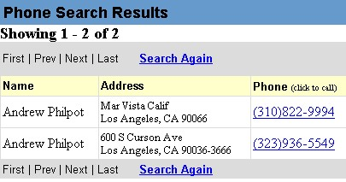
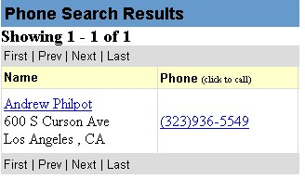
Example Source Change

Slide 69
Whitepages Wrapper
…
NAME item
Begin_Rule
__ST__ _*_
End_Rule
__ST__ </td> <td nowrap >
ADDRESS item
Begin_Rule
__ST__ </td> <td nowrap >
End_Rule
__ST__ <br>
…
NAME ADDRESS CITY
Andrew Philpot Mar Vista Calif Los Angeles
Andrew Philpot 600 S Curson Ave Los Angeles

Slide 70
Wrapper Applied to Changed Source
…
NAME item
Begin_Rule
__ST__ _*_
End_Rule
__ST__ </td> <td nowrap >
ADDRESS item
Begin_Rule
__ST__ </td> <td nowrap >
End_Rule
__ST__ <br>
…
NAME ADDRESS CITY
NIL NIL 600 S Curson Ave<BR> Los Angeles

Slide 71
After Reinduction
…
NAME item
Begin_Rule
__ST__ _*_
End_Rule
__ST__ </a> <br>
ADDRESS item
Begin_Rule
__ST__ </a> <br>
End_Rule
__ST__ <br>
…
NAME ADDRESS CITY
Andrew Philpot 600 S Curson Ave Los Angeles

Slide 72
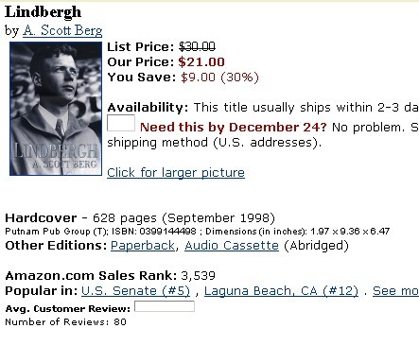
Amazon Source
TITLE item
Begin_Rule
__ST__ " colid "
value = " " > <font size
= + 1 > <b>
End_Rule
__ST__ </b> </font>
<br> by <a href = " /
PRICE item
Begin_Rule
__ST__ <b> Our Price :
<font color = # 990000 > $
End_Rule
__ST__ </font> </b>
<br> _HT
AUTHOR TITLE PRICE AVAILABILITY
A.Scott Berg Lindbergh 21.00 This title usually ships…

Slide 73
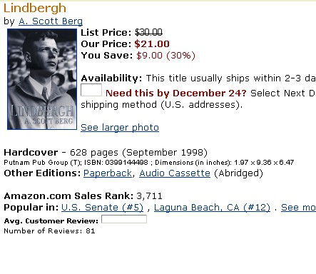
Changed Amazon Source
AUTHOR TITLE PRICE AVAILABILITY
NIL NIL 21.00 This title usually ships…

Slide 74
After Reinduction
TITLE item
Begin_Rule
__ST__ > <strong> <font
color = # CC6600 >
End_Rule
__ST__ </font> </strong>
<font size
PRICE item
Begin_Rule
__ST___ <b> Our Price :
<font color = # 990000 > $
AUTHOR TITLE PRICE AVAILABILITY
A.Scott Berg Lindbergh 21.00 This title usually ships…

Slide 75
Wrapper Reinduction
Results
Monitored 10 distinct sources
There were 8 changes over ~ 1 year
Extracting examples:
277/338 correct (82%)
31 false positives/30 false negatives
Reinduction:
Average recall = 90%
Average precision = 80%
Notes:
Though the precision was low, the recall and overall accuracy are high.
Several factors were responsible for the high number of false positives. The main reason the distributions differed was because of changes in the experimental setup. These included changes in the query set, either because new queries were added or for dated queries, they were modified. Another experimental factor was Web site performance, if the web site was too slow, the wrapper did not get results for every single query.
A more interesting reason for false positive was a few cases in which the data on the web site has actually changed. For example, we were extracting company names with one wrapper, and when the name of one of the companies changed, we detected this as a wrapper change. In another case, on amazon site, the availability of several books changed from “Ships in 24 hours” to “Ships in 2-3 days”. This was also detected as a wrapper change. We are investigating methods that will decrease the rate of false positives in wrapper verification.

Slide 76
Discussion
Flexible data representation scheme
Algorithm to learn description of data fields
Used in wrapper maintenance applications
Limitations:
Needs to be extended to lists and tables
Excellent recall, but lower precision will result in many false positives

